Slide 1

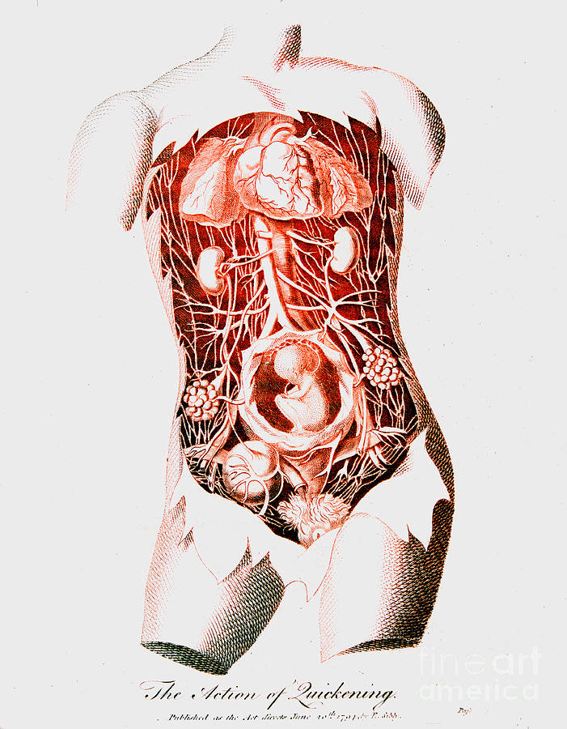


COMPETENCY 1:
Feedback Mechanisms Involved in
Regulating Processes in the
Female
Reproductive System

Slide 2
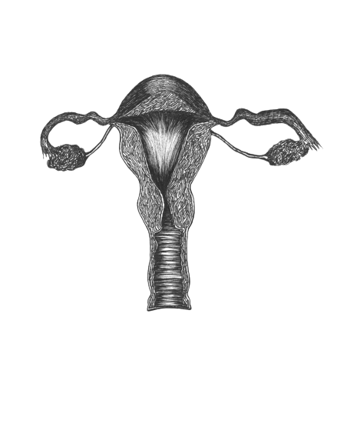

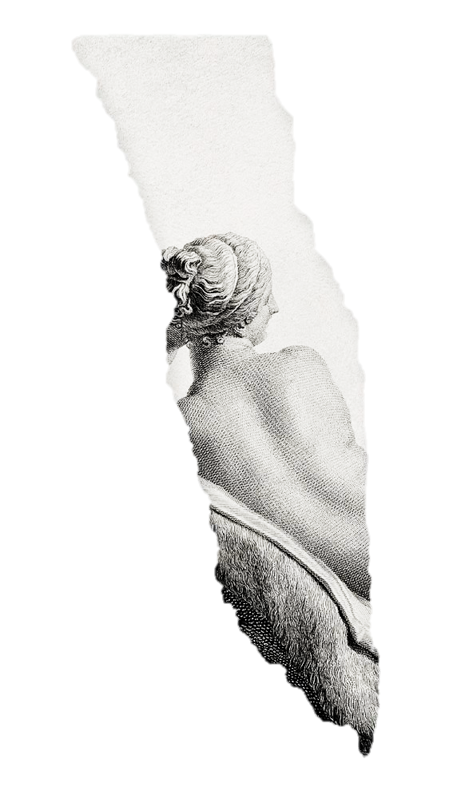


Content Standards:
The learners demonstrate an understanding of organisms as having feedback mechanisms, which are coordinated by the nervous and endocrine systems.
Competency:
Describe the feedback mechanisms involved in regulating processes in the female reproductive system (e.g., menstrual cycle) S10LT- IIIc -35.
Objectives:
At the end of the material the student will be able to:
identify the phases and important events that happen during the menstrual cycle;
describe the feedback mechanisms involved in regulating processes in the female reproductive system; and
appreciating the importance of learning how the body works together with the hormones to promote self-care.

Slide 3
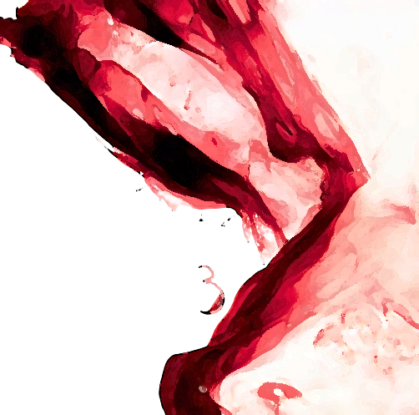
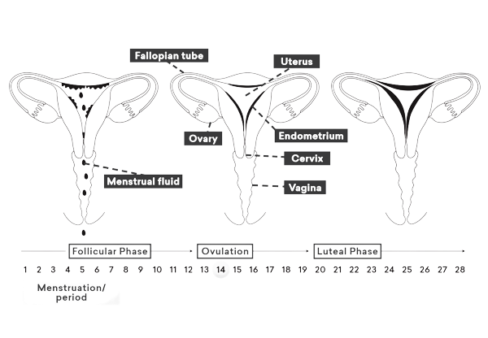
Introduction
We have learned that, on average, an ovary releases only one egg every 28 days. Now, what controls this timing? Hormones control many of the changes in the reproductive system. Remember that hormones are chemicals that affect certain body organs.

Slide 4
Introduction
Menstrual Cycle
- is the monthly hormonal cycle a female’s body goes through to prepare for pregnancy. Regular menstrual cycles between puberty (usually 12-14 years old) and menopause (usually 45-55 years old) are usually a sign that your body is working normally.
Menstruation
- is the monthly change that takes place in the female reproductive system. And when blood and tissue from the uterus come out from the vagina.
Ovulation
- is when releasing of an egg from your ovary, into your fallopian tube.

Slide 5
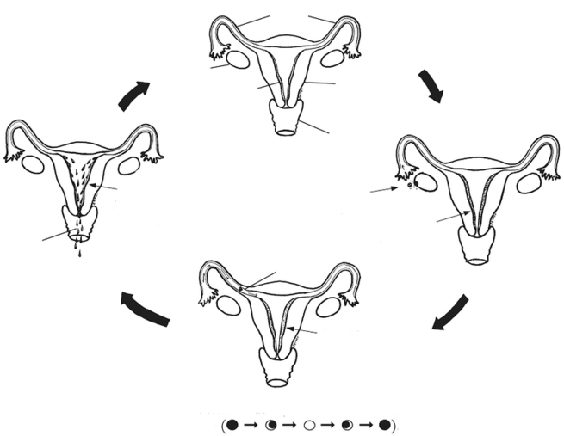

PHASES OF THE
Menstrual Cycle
THE ENDOMETRIUM BREAKS DOWN.
BLOOD
1. Menstrual Phase
- menstruation occurs

Slide 6

PHASES OF THE
Menstrual Cycle
FALLOPIAN TUBE
2. Follicular Phase
- pituitary gland releases (FSH) to create follicles that contain an immature egg. As a follicle matures, the body releases extra estrogen which stimulates the uterine lining to thicken to provide the necessary nutrients to a fertilized egg.
OVARY
UTERUS
ENDOMETRIUM
VAGINA

Slide 7

PHASES OF THE
Menstrual Cycle
WHEN THE OVARY
RELEASES AN EGG (OVULATION)
THICKENING OF ENDOMETRIUM
.
3. Ovulation Phase
- it starts when rising estrogen levels signal the pituitary to release LH to stimulate the ovulation process. The egg can survive for about 24 hours before it must be fertilized. If it doesn’t get fertilized at that point, the egg will dissolve.

Slide 8
PHASES OF THE
Menstrual Cycle
EGG GETS RELEASED
4. Luteal Phase
5 DAYS AFTER
OVULATION, THE ENDOMETRIUM BECOMES EVEN THICKER…
- if the mature egg is fertilized, the body will produce Human Chorionic Gonadotropin (HCG) which will help to keep the uterine lining thick for the fertilized egg to develop into an embryo. And also, if the egg doesn’t get fertilized during ovulation, the corpus luteum will dissolve in the body and disappear.

Slide 9
PHASES OF THE
Menstrual Cycle
FOR MOST WOMEN, THE WHOLE MENSTRUAL CYCLE TAKES ABOUT 28 DAYS - JUST LIKE THE CYCLE OF THE MOON

Slide 10
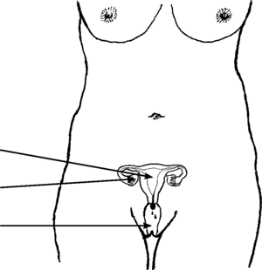

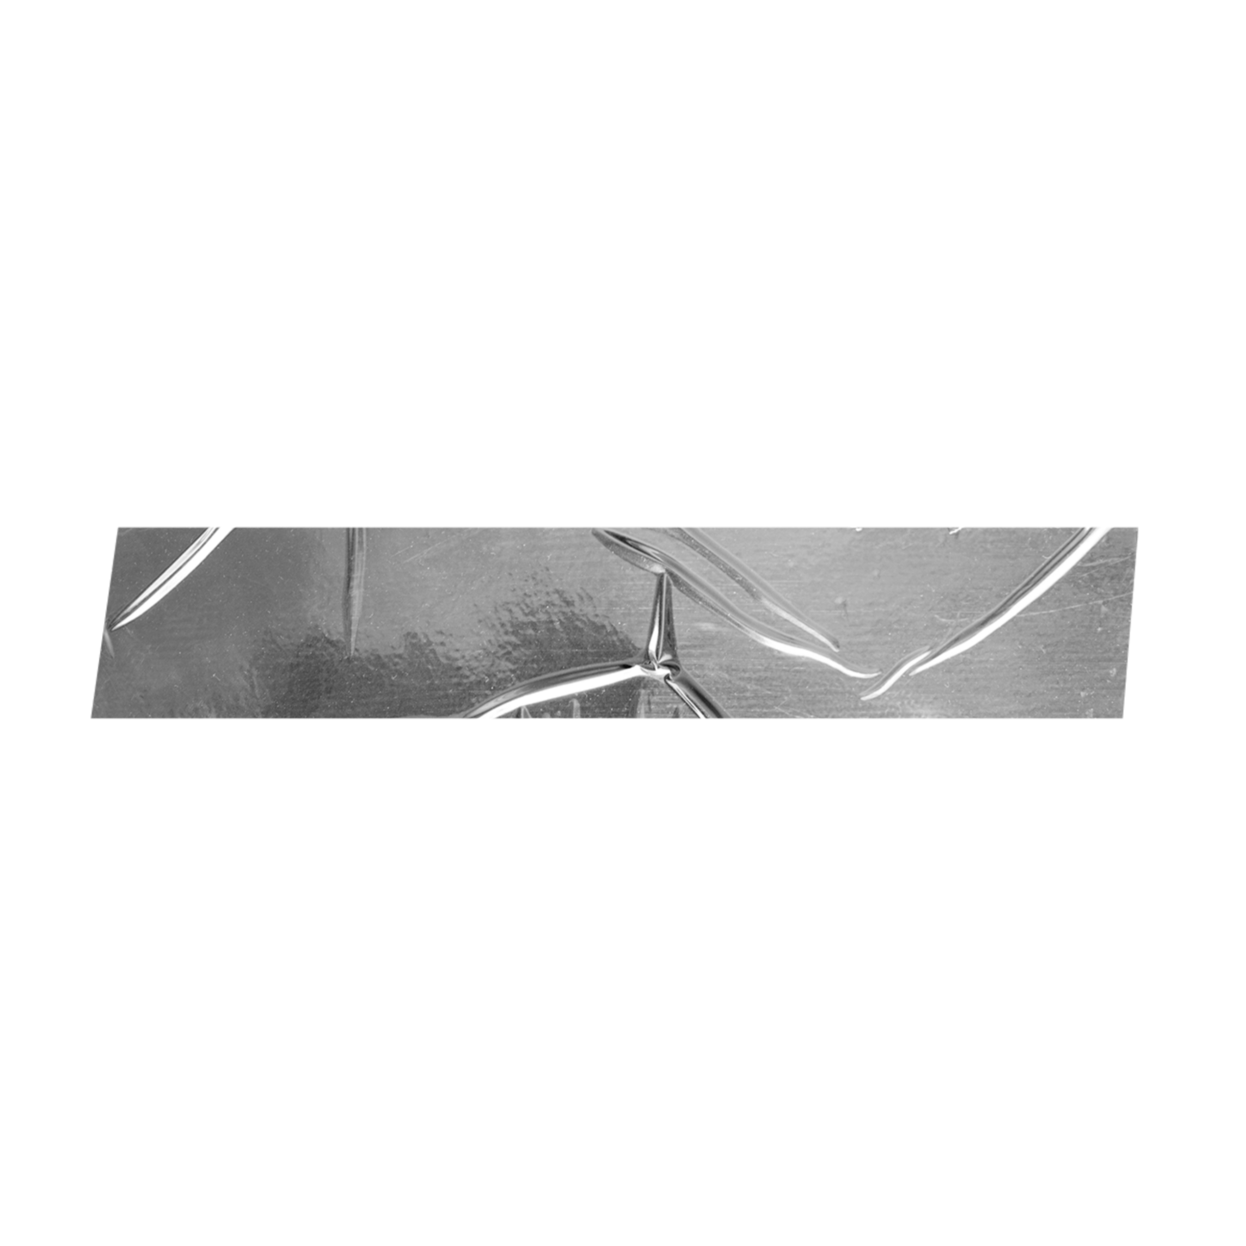
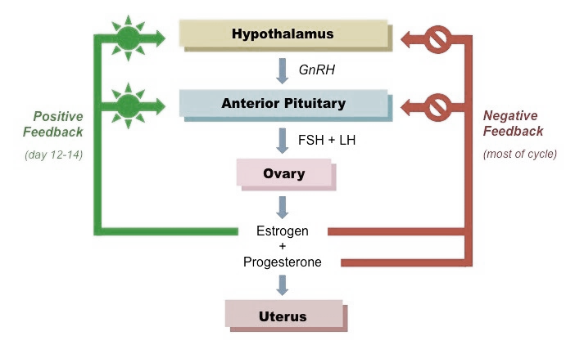

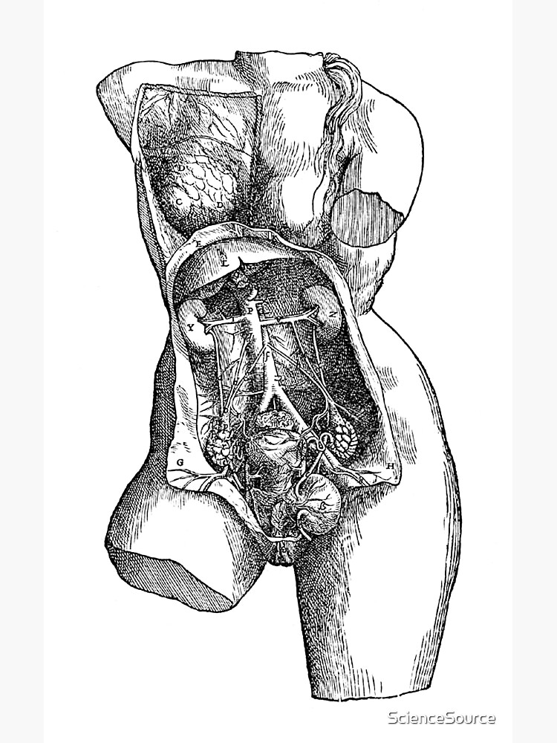
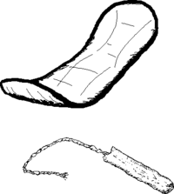
FEEDBACK MECHANISMS IN THE
Menstrual Cycle
Hormones control the menstrual cycle with negative and positive feedback.
The Negative Feedback Mechanism
is the increasing levels of hormone feedback directly to the hypothalamus and pituitary gland to decrease hormone production.
The Positive Feedback Mechanism
the increasing levels of hormones present feedback for the hormone production to increase.

Slide 11
FEEDBACK MECHANISMS IN THE
Menstrual Cycle
1. Follicle-stimulating hormone (FSH) stimulates the ovaries to release estrogen. High levels of estrogen then prevent the further production of FSH.
2. Estrogen also stimulates the release of luteinizing hormone (LH) from the pituitary gland, which in turn controls the production of progesterone. High levels of progesterone then inhibit the further release of LH.

Slide 12
Station 1:
Activity 1
Activity 2
Assessment 1

Slide 13


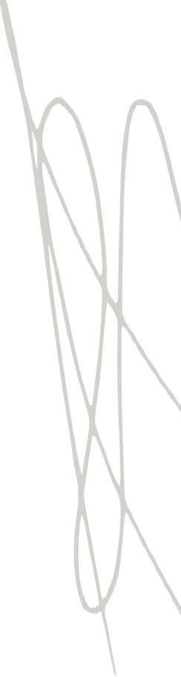
ACTIVITY 1
Mark My Calendar!
(Think, Pair, Share)
Objective:
Describe the feedback mechanisms involved in regulating processes in the female reproductive system.
Materials:
i. 2 Calendar charts
ii. Diagram of the male and female reproductive system
iii. Scissors
Tape or glue
Procedure:
Part A - For no fertilization:
Get a calendar, with an approximate size of 8 × 11 inches. It must
be marked by the day-to-day changes in the menstrual cycle.
b. Note that certain events are marked on certain days.
c. Make a copy of diagrams of the menstrual cycle like in Figure 12. Some of the diagrams will show events in the ovary, and some will show events in the uterus. They are not in proper order. Cut out each square.
d. Place the diagram in the space to the right of the corresponding description.
e. Tape or glue your diagrams in the right places/ dates where they occur.
f. Make sure that they are correctly placed.

Slide 14
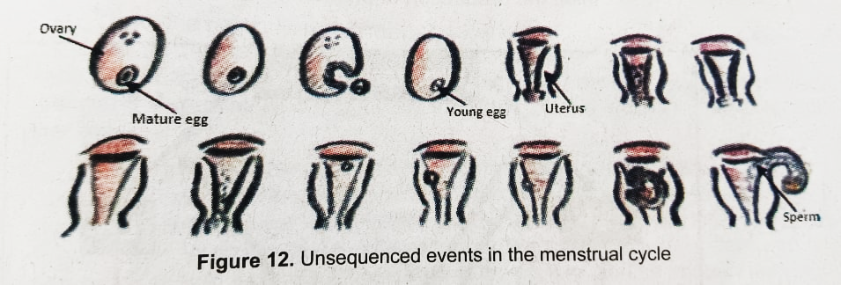
ACTIVITY 1
Mark My Calendar!
(Think, Pair, Share)
Objective:
Describe the feedback mechanisms involved in regulating processes in the female reproductive system.
Materials:
i. 2 Calendar charts
ii. Diagram of the male and female reproductive system
iii. Scissors
Tape or glue
Procedure:
Part A - For no fertilization:
Get a calendar, with an approximate size of 8 × 11 inches. It must
be marked by the day-to-day changes in the menstrual cycle.
b. Note that certain events are marked on certain days.
Make a copy of diagrams of the menstrual cycle like in Figure 12.
Some of the diagrams will show events in the ovary, and some will
show events in the uterus. They are not in proper order. Cut out
each square.
Place the diagram in the space to the right of the corresponding
description.
Tape or glue your diagrams in the right places/ dates where they
occur.
Make sure that they are correctly placed.

Slide 15
Part B - With fertilization of the egg:
Get another calendar marked by the day-to-day changes in the menstrual cycle.
You will be given a set of diagrams to place on the calendar. The diagrams will not be in proper order. You may not need all the diagrams that show the uterus.
Guide Questions:
How long does a regular menstrual cycle last?
Describe what happens to an egg during the first 14 days of the cycle in Part A.
Describe what happens to the egg if fertilization occurs.
Explain what takes place in the uterus after fertilization.
Why is it important to study the menstrual cycle?

Slide 16
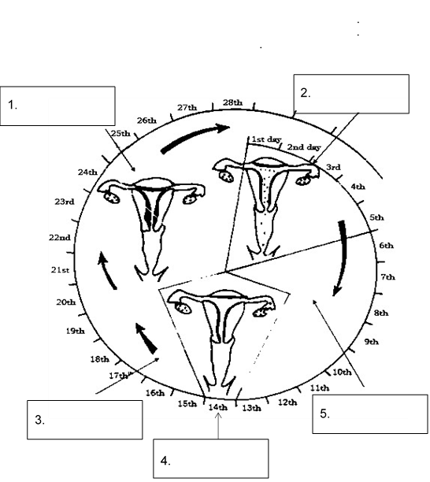
ACTIVITY 2
The Cycle Continues
Direction: Copy these sentences to the correct boxes below.
Egg is release
Menstruation happens.
If egg is fertilized it settles into thick lining
Lining starts to thicken.
Egg dies if not fertilized.

Slide 17
ASSESSMENT 1
Competency 1
Describe the feedback mechanisms involved in regulating processes in the female reproductive system (e.g., menstrual cycle) S10LT – IIIc -35
Direction: Choose the letter of the correct answer.
1. Which of the following statements are true about menstruation?
In a normal 28-day menstrual cycle you would expect menstruation to last approximately 3-5 days.
During menstruation, the entire endometrium is shed.
During menstruation, only the functional layer of the endometrium is shed, with the basal layer remaining intact.
The absence of menstruation always indicates an active pregnancy.
2. Which hormone, produced by the ovaries, stimulates the uterus lining to build up after menstruation?
Estrogen
Progesterone
Luteinizing hormone
Follicle-stimulating hormone

Slide 18
3. Which hormone, released by the pituitary gland, stimulates ovulation?
Estrogen
Progesterone
Luteinizing hormone
Follicle-stimulating hormone
4. Which hormones increase after ovulation to keep both FSH and LH levels low?
Estrogen
Progesterone
Luteinizing hormone
Follicle-stimulating hormone
5. In the luteal phase, the uterus is ready to receive a fertilized egg. Assuming that the egg cell is not fertilized by a sperm cell, what would happen to the endometrium?
It would break and shed off.
It will form a new egg cell.
It will continue to thicken.
It will not be affected.
6. Which of the following physical changes is experienced by women during the luteal stage of the menstrual cycle?
Mood swings
Changes in appetite
Depression or sadness
Headaches or backaches

Slide 19
7. What will happen inside the uterus if fertilization occurs?
The fertilized egg will get implanted in the uterus.
The uterine wall will continue to thicken for ovulation.
The uterine wall will collapse, releasing blood and tissues.
The egg cell will be fertilized by the sperm cell in the uterus.
8. Why does progesterone inhibit the release of LH after ovulation has occurred?
So only one egg is released from the ovaries
So multiple eggs can be released from the ovaries
So, the uterus lining can be broken down during menstruation
So FSH can be produced and can stimulate the egg to mature
9. The female ovaries are responsible for producing estrogen and progesterone. How is the ovary affected by the hormones released by the pituitary gland?
LH stimulates the release of estrogen, while FSH inhibits the release of progesterone.
LH inhibits the release of estrogen while FSH stimulates the release of progesterone.
FSH causes the follicle to grow in the ovary while LH causes the release of the egg cell.
FSH causes the release of the egg cell in the ovary while LH causes the growth of the follicles.

Slide 20
10. Which of the following are functions of progesterone?
Inhibition of estrogen production.
Does not inhibit LH and FSH production.
Initiation of the other phase of the endometrium.
Increase in basal body temperature.
11. Which of the following symptoms indicate that a woman is about to ovulate?
Decrease in basal body temperature.
Increase in basal body temperature.
Thickening of cervical mucous.
Thinning of cervical mucous.

Slide 21

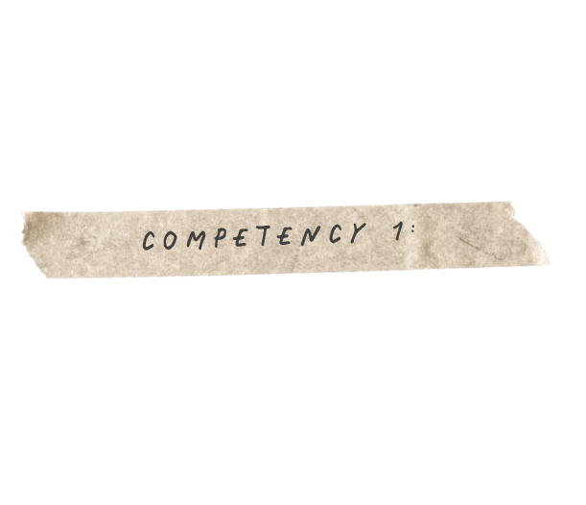
Thank You!
Feedback Mechanisms Involved in
Regulating Processes in the Female Reproductive System

